Slide 1

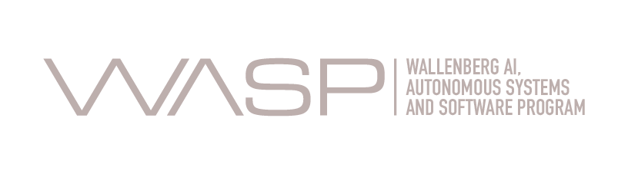
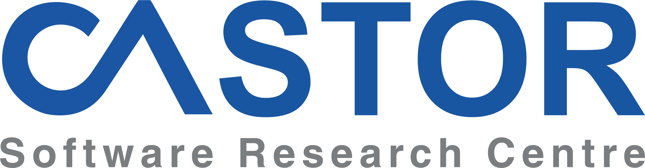
DepClean: Automatically revealing bloated software dependencies in Maven projects
César Soto Valero
, Nicolas Harrand,
Martin Monperrus
, and Benoit Baudry

Slide 2
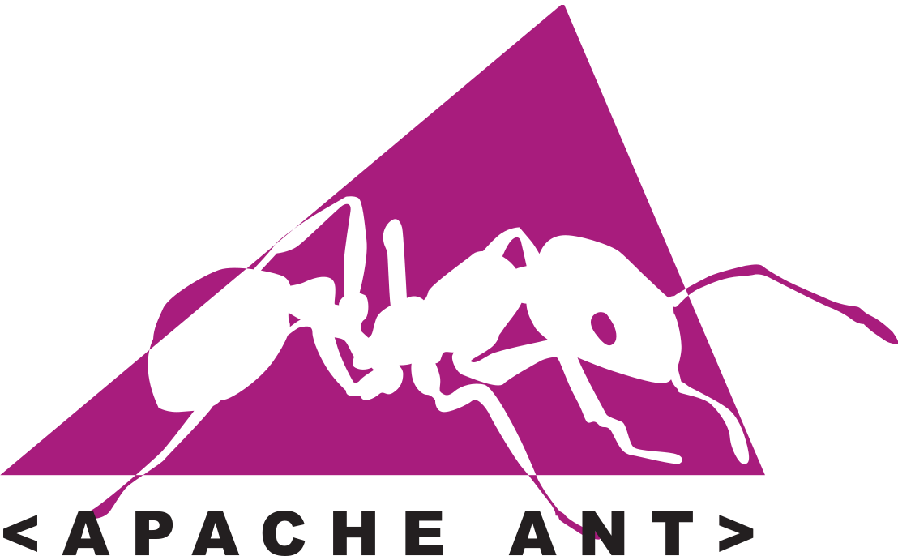



Dependency managers in Java
build.xml
pom.xml
build.gradle
Notes:
So, let me start by giving a little bit of context about dependency managers in Java
1- Apache Ant was a successful build tool for Java,but it had some drawbacks such as the lack of formal conventions regarding the project structure, it is also procedural in the sense that you need to provide information about what to do and when to do through code, in a giving order, and most of the Ant scripts are not reusable.
2- Then, Maven appeared as a build tool with a much declarative build file called the pom.xml file, Maven has a clear convention of where to place the source code, the compiled code, etc.
3- Gradle is another popular dependency management tool for Java. It uses domain-specific language based on the programming language Groovy, differentiating it from Ant and Maven, which use XML for its project configuration

Slide 3
What does Maven offer?
Build projects (compile, test, deploy)
Resolve dependencies automatically
Execute tests, add documentation, manage resources, etc.
Release software artifacts to Maven Central
Guarantee reproducible builds (pom.xml file)
Provide consistent project structure
Allow us to use customized plugins
Analyze the dependencies in our projects
Notes:
Using the Maven dependency management tool has several benefits for developers.
1- The main task of Maven is to build Java projects. This process is divided into several phases, which include the compilation of the source code, the execution of the test suite, and the deployment of the compiled artifact to some external repository.
2- The first step to build a Maven project is to resolve all the dependencies of the project. This process consists of downloading all the dependencies necessary to build the project and put them into the local repository.
3- Once all the dependencies are downloaded, Maven can execute the test, add documentation, manage resources, and release the software Artifact to Maven Central, which is the most popular repository of Maven artifacts.
An important feature of Maven is that it guarantees the reproducibility of builds since every build is based on the same pom.xml file.
4- Since Maven provides a consistent structure for our project
5- This allows us to implement additional tasks in the form of customized plugins
6- For example, to analyze the dependencies in our projects
So, let’s focus on the dependencies.
In this talk, we are going to provide an answer to the following fundamental question:

Slide 4
How many dependencies do we actually use?
Notes:
How many dependencies do we actually use?

Slide 5
Dependency tree
Q
<parent> <groupId>org.Q</groupId> <artifactId>Q</artifactId> </parent>
Inherited dependency
P
G
<dependency> <groupId>org.A</groupId> <artifactId>A</artifactId> </dependency>
<dependency> <groupId>org.B</groupId> <artifactId>B</artifactId> </dependency>
<dependency> <groupId>org.C</groupId> <artifactId>C</artifactId> </dependency>
Direct dependencies
A
B
C
Transitive dependencies
D
E
F
Notes:
Let’s say that we have a project P.
In the pom.xml we declare three dependencies, A, B, and C. These are direct dependencies of project P.
But the dependency A also has other dependencies, D and E, and dependency C has a depenency F. D, E, and F are called transitive dependencies of project P.
On the other hand, this project P declares the module Q as his parent, and Q declares a direct dependency G. So, in this context G becomes an inherited dependency of project P.
In summary, we can distinguish three types of dependencies in the dependency tree of P: direct dependencies, transitive dependencies, and inherited dependencies.

Slide 6
Dependency tree
Q
P
G
A
B
C
D
E
F
Notes:
This the dependency tree of P as interpreted by Maven

Slide 7
Dependency tree
Q
P
G
A
B
C
D
E
F
Notes:
But, let’s see how these dependencies are actually used.

Slide 8
Bytecode calls
Q
P
G
A
B
C
D
E
F
Notes:
If we forget about the dependency tree structure for a moment and look at the bytecode calls made by the project P, we can see that there is a set of instructions in P that call another set of instructions in the dependency A. And this set of instructions in A calls another subset of the transitive dependency D.
Interestingly, we can also see that the depency F is is used by a subset of P.
So, in this context, the dependency tree of P is still the same but there are dependencies that are not needed.
P doesn’t need B, it does’t need C, E, or G.
We call these bloated dependencies, and we believe that they should be removed.

Slide 9
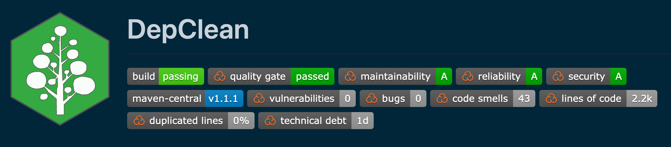
DepClean
Detect and report bloated dependencies
In the context of an artifact
On the whole dependency tree
Automatic generation of a debloated pom.xml file
Open source
https://github.com/castor-software/depclean
Notes:
To do so, we developed DepClean.
- It detects and reports bloated dependencies to developers.
- DepClean works in the context of a Maven artifact, so, given an artifact, it analyzes its whole dependency tree and produces a report with information about the usage status of each dependency. These are two unique features of DepClean. There is a Maven plugin called the maven-dependency-analyzer that provides a report about the status of usage status of dependencies, but it doesn’t analyze transitive dependencies in the context of our project and doesn’t distinguish between transitive and inherited dependencies.
-Another important feature of DepClean is that it produces an alternative pom.xml file with all the bloated dependencies removed. So, developers can use this pom file directly in their projects.
-And DepClean is open source and publicly available on GitHub.

Slide 10
Debloat direct dependencies
Q
P
G
- <dependency> - <groupId>org.B</groupId> - <artifactId>B</artifactId> - </dependency>
- <dependency> - <groupId>org.C</groupId> - <artifactId>C</artifactId> - </dependency>
A
B
C
D
E
F
Notes:
So, coming back to our example.
DepClean starts by looking at the part of the code in P that calls third-party dependencies.
In this example, there are two sets in P, one of them uses a subset of the dependency A, and the other uses a subset of the dependency F.
And, as we can see, the project P doesn’t use the direct dependencies B and C, so we can remove these dependencies from P.
- To do so, we just need to remove a couple of entries in the dependencies declaration of the pom file of P.

Slide 11
Debloat transitive dependencies
Q
P
G
<dependency> <groupId>org.A</groupId> <artifactId>A</artifactId>
+ <exclusions> + <exclusion> + <groupId>org.E</groupId> + <artifactId>E</artifactId> + </exclusion> + </exclusions> </dependency>
A
D
E
F
Notes:
Now, we can see that the part of A that is used by P, calls some instructions of the dependency D.
But it doesn’t call any API member of E.
So, in the context of the project P, which is the one that we are analyzing, the transitive dependency D is used, while the transitive dependency E is bloated.
Notice that maybe A uses E. However, in the context of the project P, E is not used because it doesn’t exist any bytecode call to E in the part of A that is used by P.
- This way, E can be safely excluded from A in the pom, which means that it will no longer be part of the dependency tree of P

Slide 12
Debloat inherited dependencies
Q
P
G
- <parent> - <groupId>org.Q</groupId> - <artifactId>Q</artifactId> - </parent>
A
D
F
Notes:
On the other hand, DepClean reports that the parent module Q of P, as well as the inherited dependency G are not necessary.
In other words, there is no bytecode call from P to any of them.
So, the developers of P can remove this parent declaration from the pom if they want to.
I mean, it is safe to do it if the only purpose of having a parent module is to inherit dependencies. Although as we know, there are many other reasons to have modules.
But, in terms of the dependency tree, this change is gonna make it smaller.

Slide 13
Debloat analysis result
P
A
F
D
Notes:
So, at the end, P only actually uses three dependencies: A, D, and F

Slide 14
Debloated dependency tree
P
A
F
D
Notes:
And the debloat result of using DepClean is an smaller dependency tree

Slide 15
Debloated dependency tree
P
A
F
D
Notes:
With only three used dependencies

Slide 16
Objective
Q
P
G
P
debloat
A
B
C
A
F
D
E
F
D
The objective of DepClean is to reduce the size of the dependency tree by debloating unused dependencies, automatically.
Notes:
To sum up, the main objective of DepClean is, for a given Maven project P, to debloat its dependency tree and produce a version of it without bloated dependencies.

Slide 17
DepClean
Based on static analysis
Available as a Maven goal with various configurations
Q
<plugin> <groupId>se.kth.castor</groupId> <artifactId>depclean-maven-plugin</artifactId> <version>1.1.1</version> <executions> <execution> <goals> <goal>depclean</goal> </goals> </execution> </executions> </plugin>
P
G
A
B
C
D
E
F
Notes:
- DepClean performs the analysis based on static analysis of the bytecode calls.
It doesn’t need the source code of a project to run the analysis. It can analyze the bytecode of compiled artifacts directly.
- Depclean is implemented as a Maven plugin. This means that it can be easily added to any continuous integration pipeline. It also provides several configurations. For example, to break the build if it detects any bloated direct dependency. This way, developers can protect their projects from the arrival of new bloated dependencies.

Slide 18
How much dependency bloat exists out there?
Notes:
Having DepClean in our toolset, one question arises immediately.
How much dependency bloat exists out there, in the wild? In the whole Maven ecosystem.

Slide 19
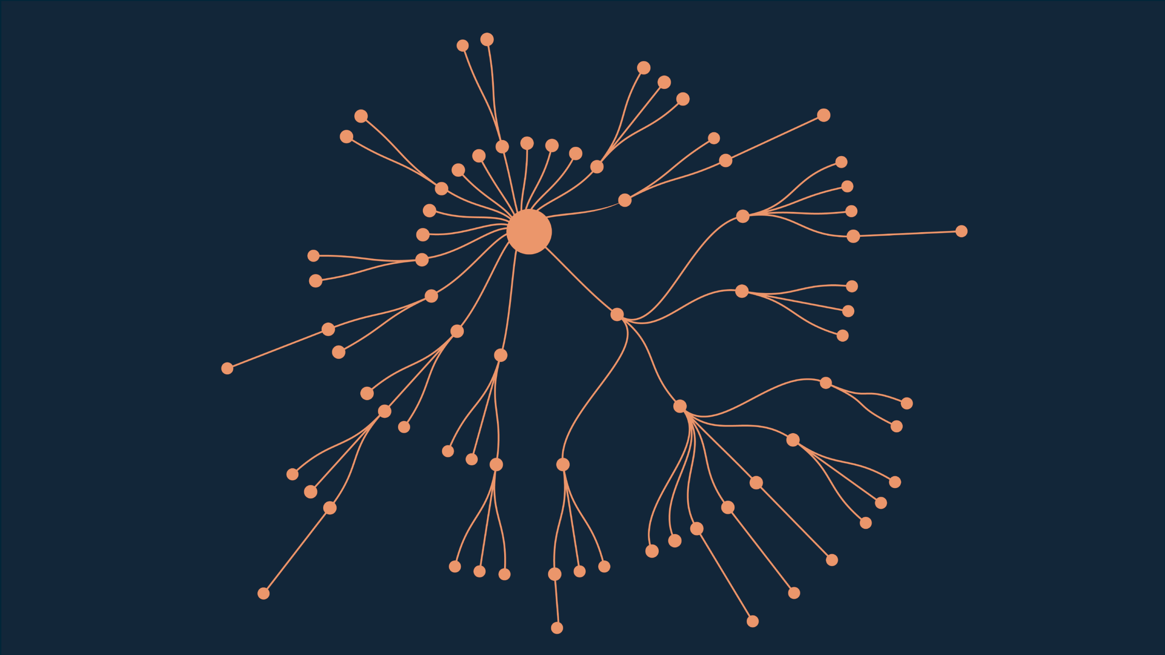
Example: Spoon library
Open source library for code analysis, 75 dependencies
https://github.com/INRIA/spoon
Notes:
Let’s see a real example.
This is the dependency tree of Spoon, a library for metaprogramming and source code analysis.
It contains a total of 75 dependencies.
As we can observe, there are both direct and transitive dependencies.

Slide 20

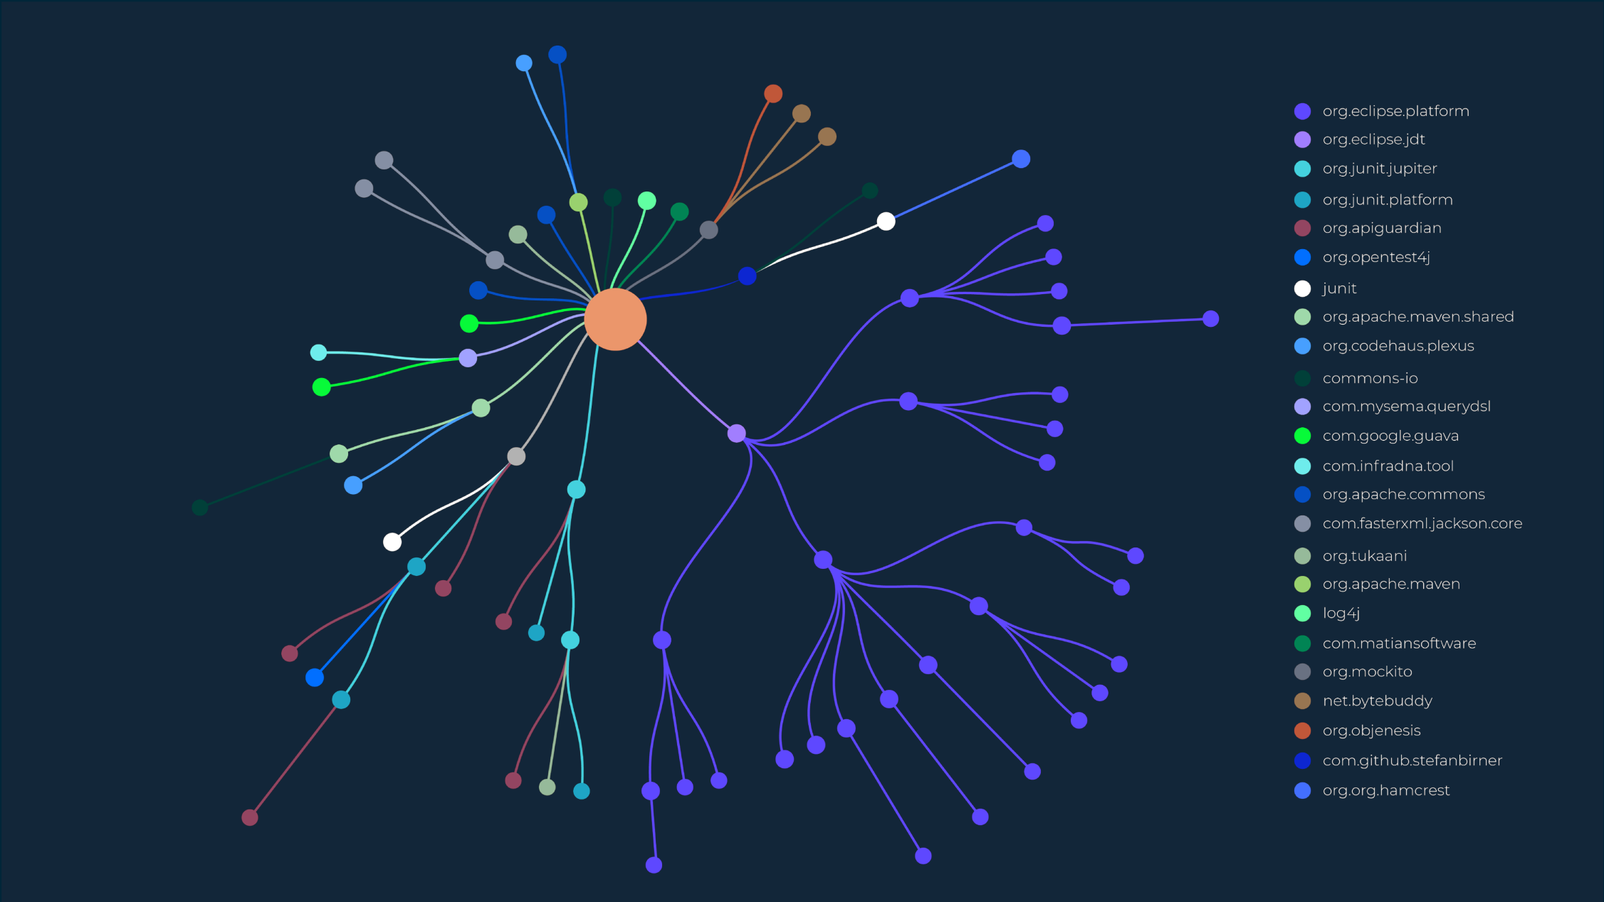
Example: Spoon library
24 different dependency providers
https://github.com/INRIA/spoon

Slide 21
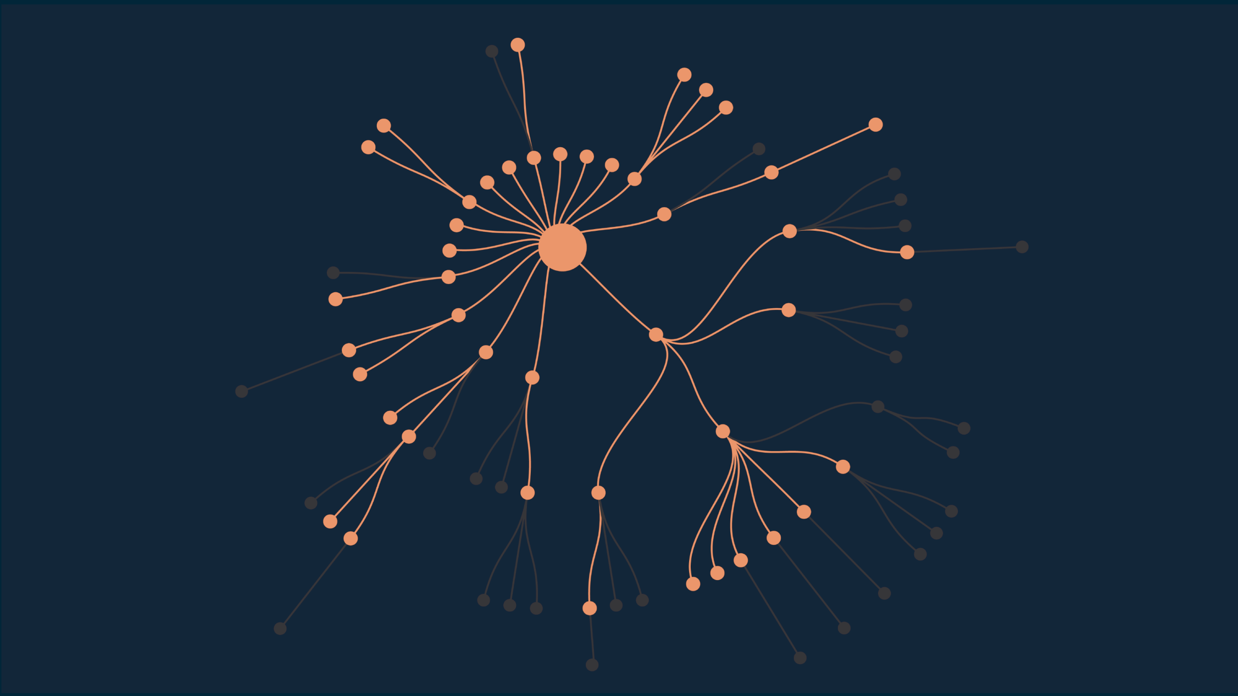
Regular Maven analysis
Maven excludes 31 redundant dependencies
https://github.com/INRIA/spoon
Notes:
Maven, as part of its analysis, excludes a total of 31 dependencies from its dependency tree.
These are redundant dependencies, which basically means that they are duplicated versions of the same provider.

Slide 22
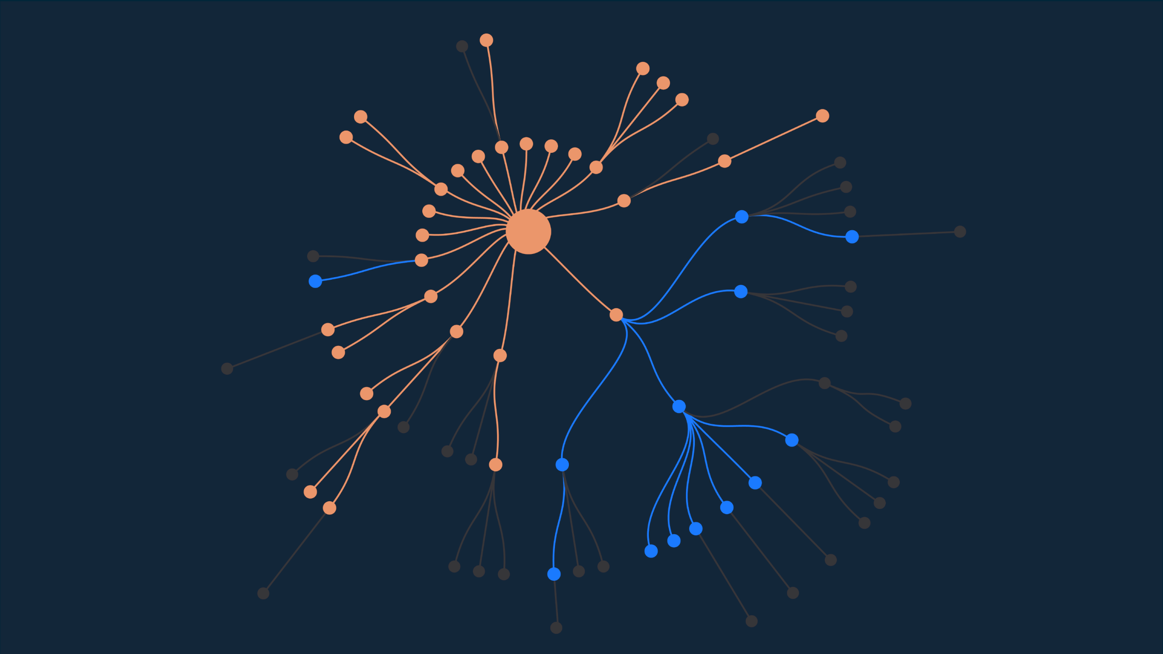
DepClean novel analysis
DepClean detects 13 bloated dependencies
https://github.com/INRIA/spoon
Notes:
After this, DepClean performs its novel dependency analysis.
It detects 13 bloated transitive dependencies in Spoon.

Slide 23
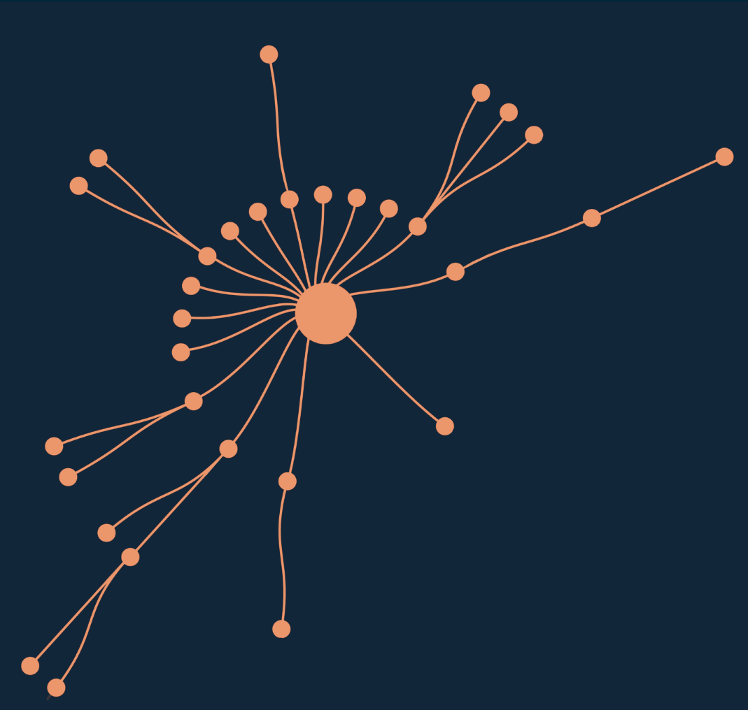
Debloated Spoon library
debloat
 | JAR Size (MB) | #Classes
Before | 16.2 | 7 425
After | 12.7 | 5 593
Reduction (%) | 27.6% | 24.7%
Notes:
So basically, we can use DepClean to transform this dependency tree.
We debloat it, remove all the unused dependencies, and obtain a much smaller version of it. And it is important to say that process doesn’t affect the build of Spoon. It will compile, the tests will be executed, and all the rest of the Maven phases will work as normal.
-Which is more important, the removal of these bloated dependencies has a very positive impact on the size and the number of classes of the library. The jar-with-dependencies of the Spoon is reduced, from 16.2MB to 12.7MB, which represents a significant reduction in size on disk of 27.6%, and a 24.7% of reduction in the number of classes.
This is the impact of using DepClean on Spoon, but, what about the whole Maven ecosystem?

Slide 24
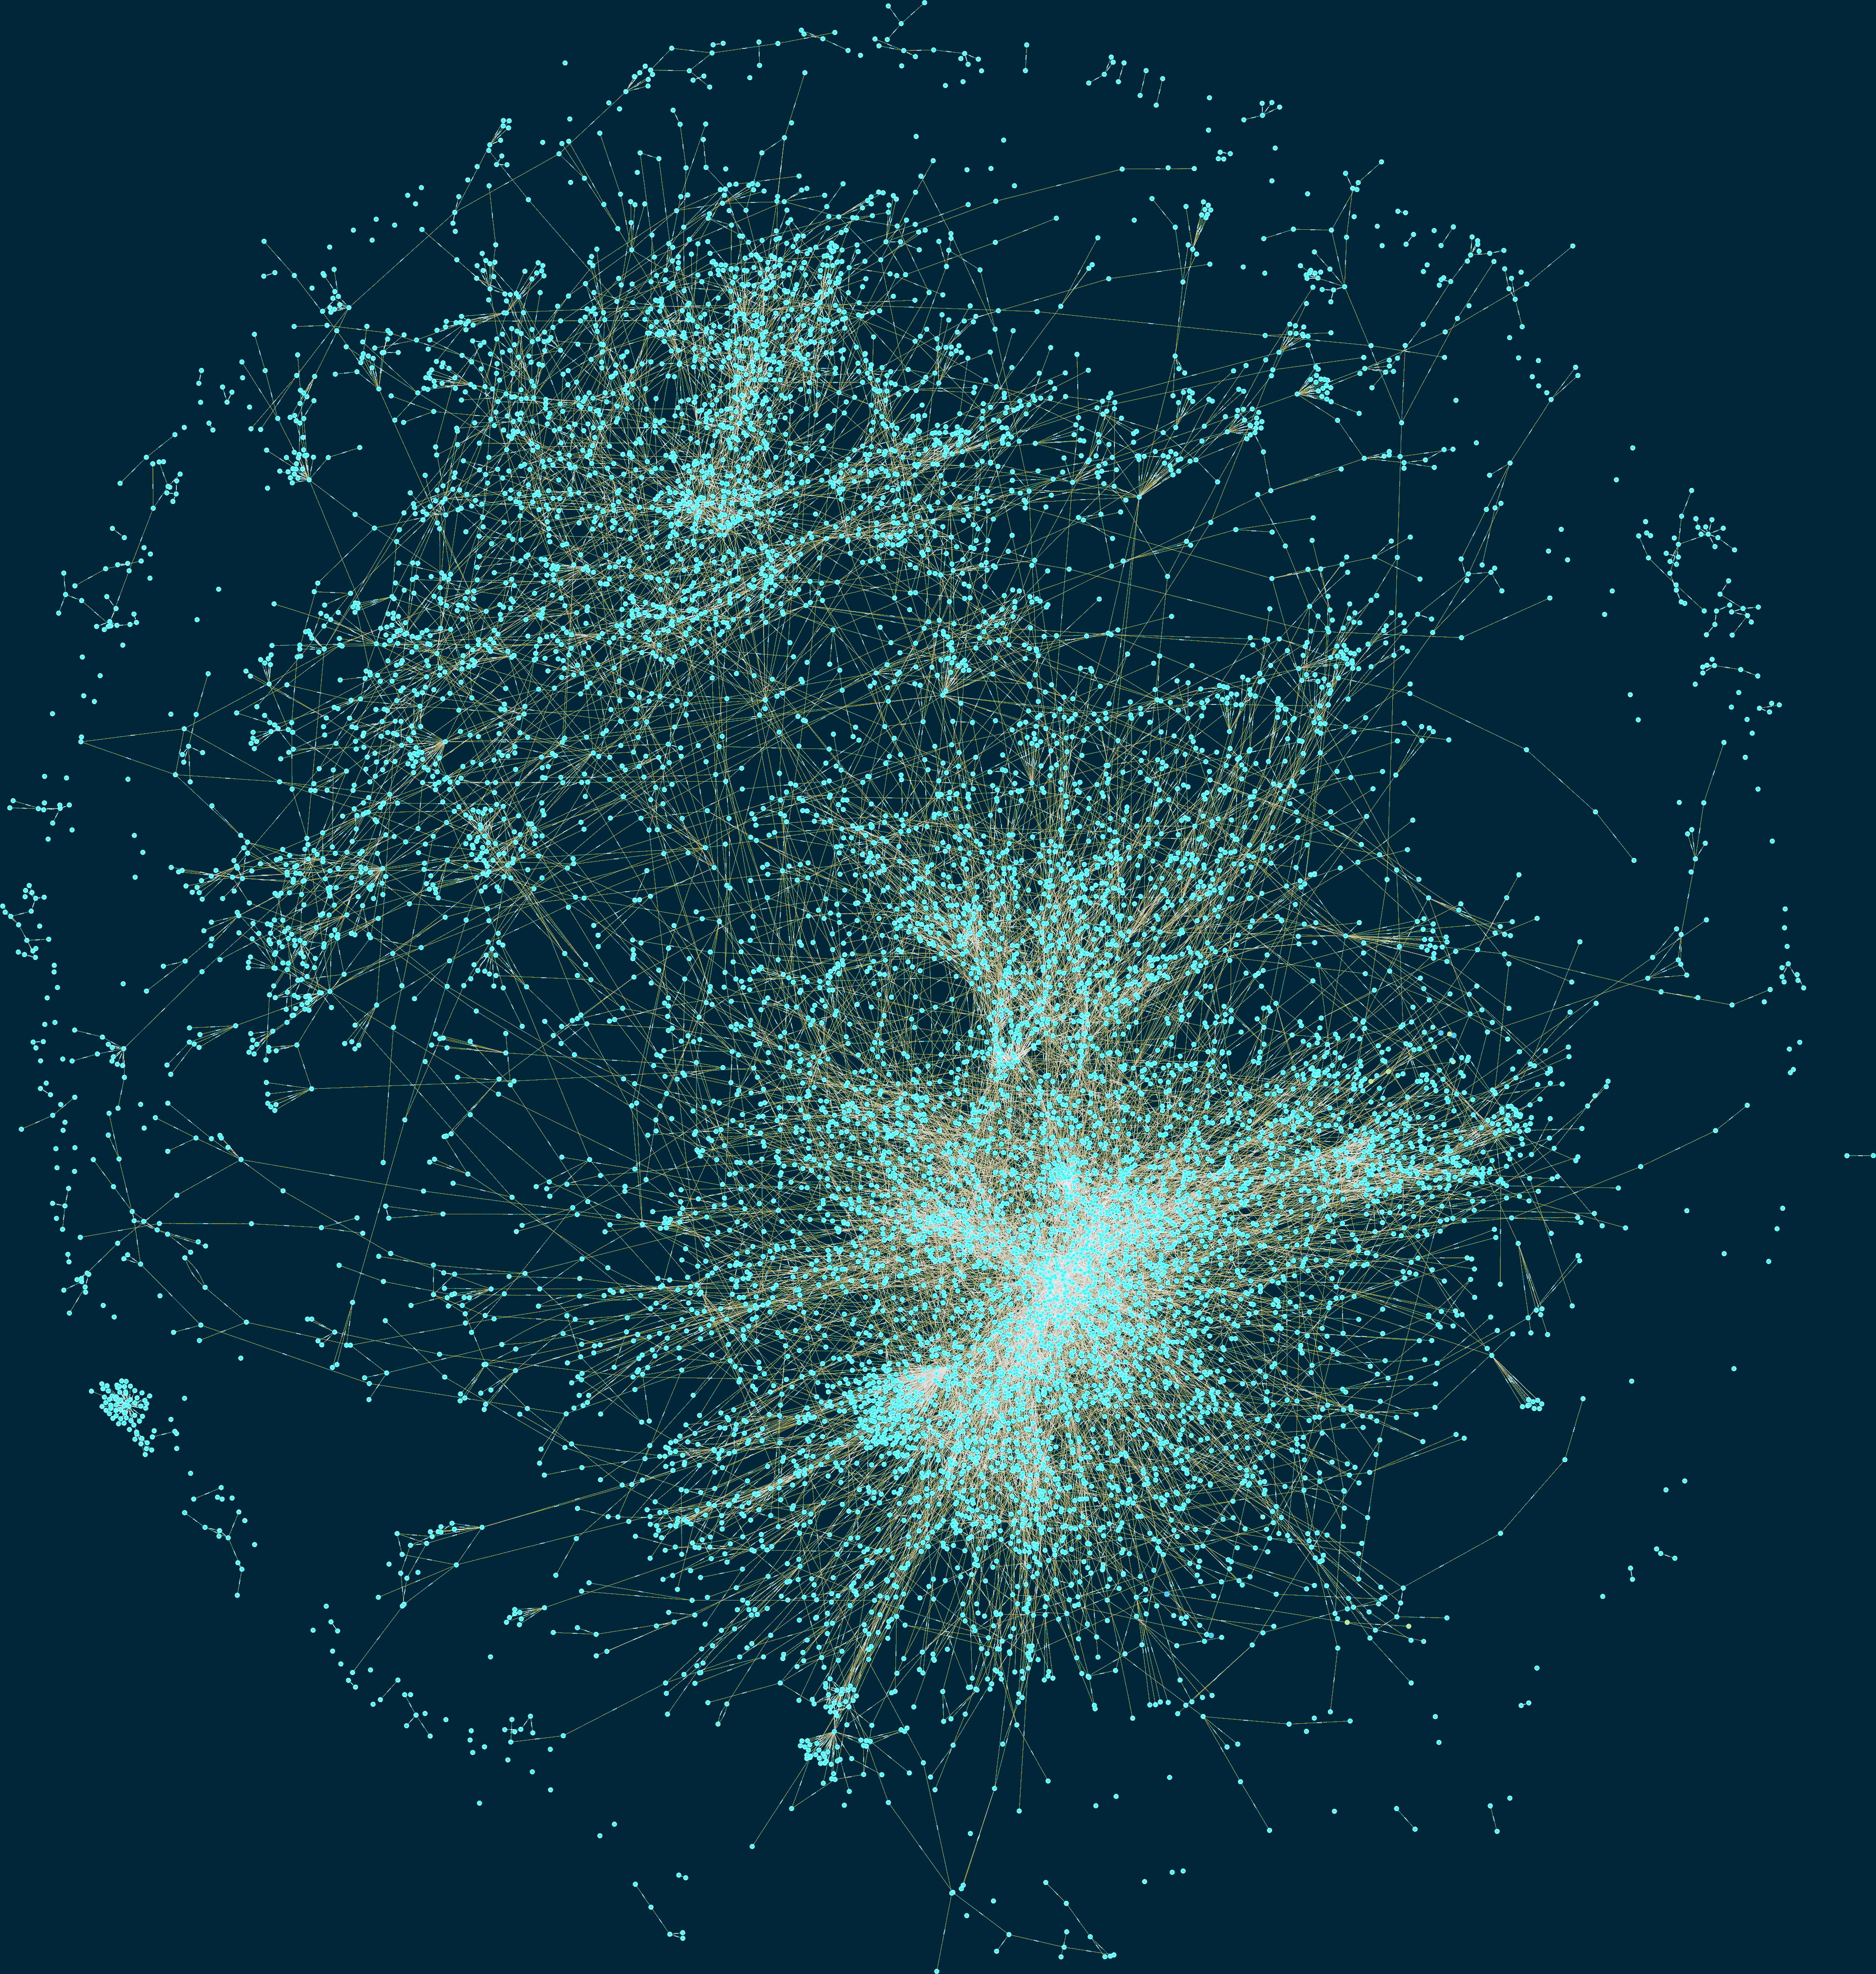
The Maven ecosystem is big
3.6 million artifacts in 2019
“The Maven Dependency Graph: a Temporal Graph-based Representation of Maven Central” (published in MSR’19)
Notes:
Well, one thing that we know is that it is big.
Two years ago, we performed an study with the objective of constructing the most precise representation of the dependency relationships between the artifacts in Maven Central.
What you see is part of the Maven Dependency Graph that we built.
- It contained 3.6 million artifacts in 2019.

Slide 25
Large scale empirical study
9K Maven artifacts
Diverse
Reused
Complex
723K dependency relationships
45K direct (6%)
180K inherited (25%)
498K transitive (69%)
“A Comprehensive Study of Bloated Dependencies in the Maven Ecosystem” (accepted for publication in EMSE 2021)
Notes:
Based on this graph we selected a set of 9 thousand Maven artifacts as study subjects.
This selection took into account several criteria, such as:
Diversity: They belong to different maven projects
Reused: The subjects are used by at least one artifact through a direct dependency declaration
Comple: They contain class files, and have at least one direct dependency with compile scope
The selected 9 thousand Maven artifacts contain a total of 723 dependency relationships,
Of which 6% are direct
25% are inherited
And 69% are transitive

Slide 26
Results
9K artifacts and 723K dependencies
2.7% of direct dependencies are bloated
15.1% of inherited dependencies are bloated
57% of transitive dependencies are bloated
“A Comprehensive Study of Bloated Dependencies in the Maven Ecosystem” (accepted for publication in EMSE 2021)
Notes:
This bar chart summarizes the results obtained.
Each bar represents the percentage of dependencies of each type (direct, inherited, and transitive) that are bloated, in blue, or used, in orange.
-The key results, from this figure, is that 2.7% of direct dependencies are bloated. This is surprising because those are dependencies explicitly declared in the pom of the Maven project, that are not necessary to build the project.
-15.1% of the inherited dependencies are bloated. This means that there is a lot of dependency bloat that is caused by the Maven inheritance mechanism, in which basically all the dependencies of a parent module are inherited by its children.
-On the other hand, 57% of the transitive dependencies are bloated. These are dependencies that are induced by direct dependencies, as a result of the Maven dependency resolution mechanism, but, they are not necessary, and therefore it is bloat

Slide 27
How much dependency bloat exists out there?
75% of all the dependency relationships are bloated
3472 (36%) artifacts have at least one bloated direct dependency declared in the pom
8305 (86%) artifacts have at least one bloated transitive dependency
“A Comprehensive Study of Bloated Dependencies in the Maven Ecosystem” (accepted for publication in EMSE 2021)
Notes:
So, to answer our initial question, how much dependency bloat exists out there?
We found that in our dataset of 9 thousand Maven artifacts
- 75% of all the dependency relationships are bloated
36% of artifacts have at least one bloated direct dependency declared in the pom, and
86.2% artifacts have at least one bloated dependency induced transitively
This is a lot of bloat, but… another question is

Slide 28
Do developers care about bloated dependencies?
Notes:
Do developers care about it?

Slide 29
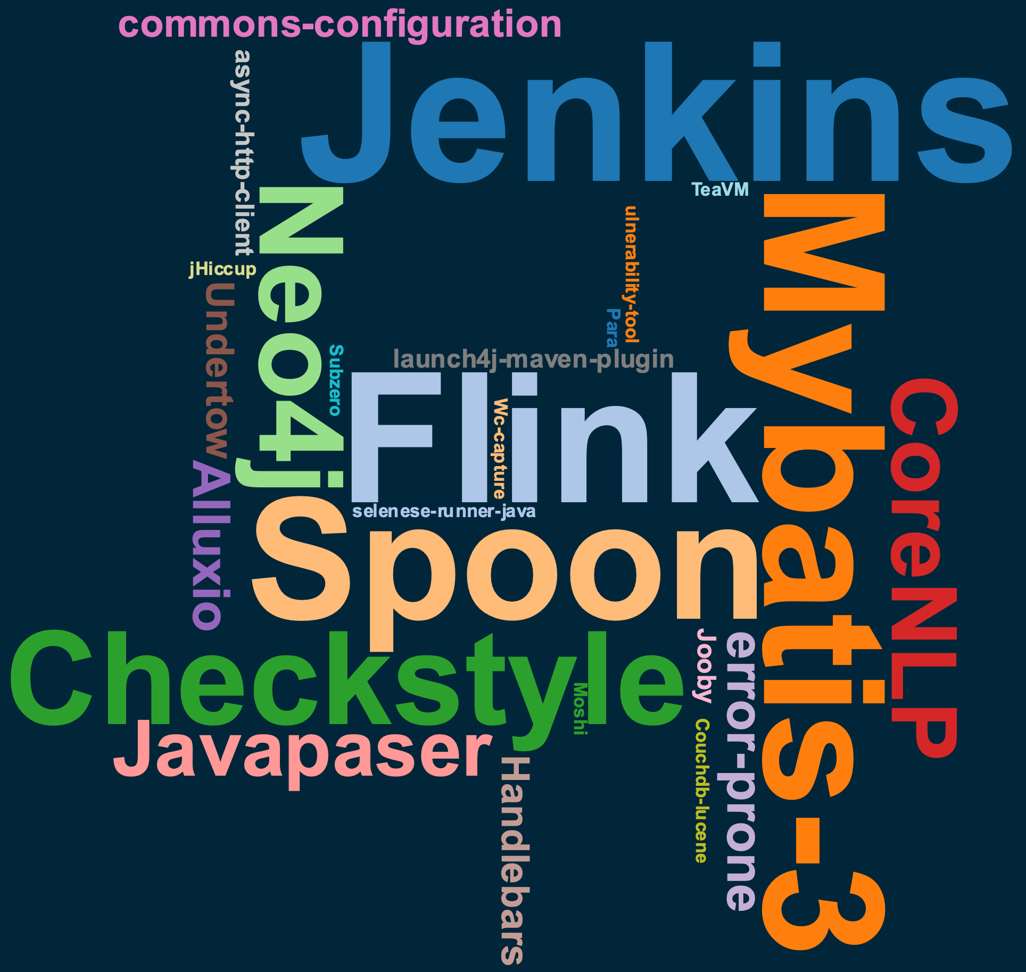
User study
30 software projects
Open source
Active
Popular
Build succesfuly with Maven
Contain dependencies
“A Comprehensive Study of Bloated Dependencies in the Maven Ecosystem” (accepted for publication in EMSE 2021)
Notes:
To answer this question, we performed a user study.
-We selected 30 projects and used DepClean to detect bloated dependencies.
-For the selection of these projects, we follow several criteria, such as
-They must be open source
-Active on GitHub
-Popular, with at least 100 starts
-They build with Maven and contain dependencies
-This word cloud shows the selected projects. Most of them are well known by the Java community, such as Jenkins, Flink, Neo4j, Checkstyle

Slide 30
Results
30 pull requests in 30 notable open source projects
“A Comprehensive Study of Bloated Dependencies in the Maven Ecosystem” (accepted for publication in EMSE 2021)
Notes:
So we use DepClean to analyze these projects and make 30 pull request, proposing the removal of bloated dependencies.
This pie chart shows the results obtained.
As we can see, 21 pull request were accepted by developers and merged into the projects
5 pull request were rejected,
And for 4 of them we receive no answer

Slide 31
Results
30 PRs in 30 notable open source projects
Removed 140 bloated dependencies in 21 projects thanks to DepClean
“A Comprehensive Study of Bloated Dependencies in the Maven Ecosystem” (accepted for publication in EMSE 2021)
Notes:
In total, 140 dependencies were removed in 21 projects.
This result indicates that removing bloated dependencies is important for developers.
They are ready to take action, and also that if we submit more pull request proposing the removal of bloated dependencies, they are likely to be accepted by developers.

Slide 32
Example: Jenkins
Bloated dependencies detected by DepClean:
jenkins-core
org.jvnet.hudson:jtidy (direct)
org.jenkins-ci:constant-pool-scanner (transitive)
net.i2p.crypto:eddsa (transitive)
jenkins-cli
commons-codec (direct)
https://github.com/jenkinsci/jenkins/pull/4378
Notes:
Let’s a example of a project that we analyze.
DepClean found bloated dependencies in the core module of Jenkins
One bloated direct, and two transitive
It also found a direct dependency bloated in the cli module of Jenkins
So, we submitted a pull request proposing the removal of these dependendencies.

Slide 33
Developers’ comments
jenkins-core
“Past experiences removing unused dependencies have consistently shown that some code will have depended on that inclusion and will be broken by it.”
“We're not precluded from removing an unused dependency, but I think that the project values compatibility more than removal of unused dependencies, so we need to be careful that removal of an unused dependency does not cause a more severe problem than it solves.”
Notes:
With respect to the bloated dependencies in jenkins-core. Developers were reluctant to remove them:
They said that past experiences removing unused dependencies have broken some clients.
They agree that these dependencies are not used, but they don’t want to remove them for compatibility reasons.
What we can learn from this case is that bloated dependencies should be removed as soon as they appear. Because otherwise some clients may depend on them and it will be more difficult to take action without breaking the clients

Slide 34
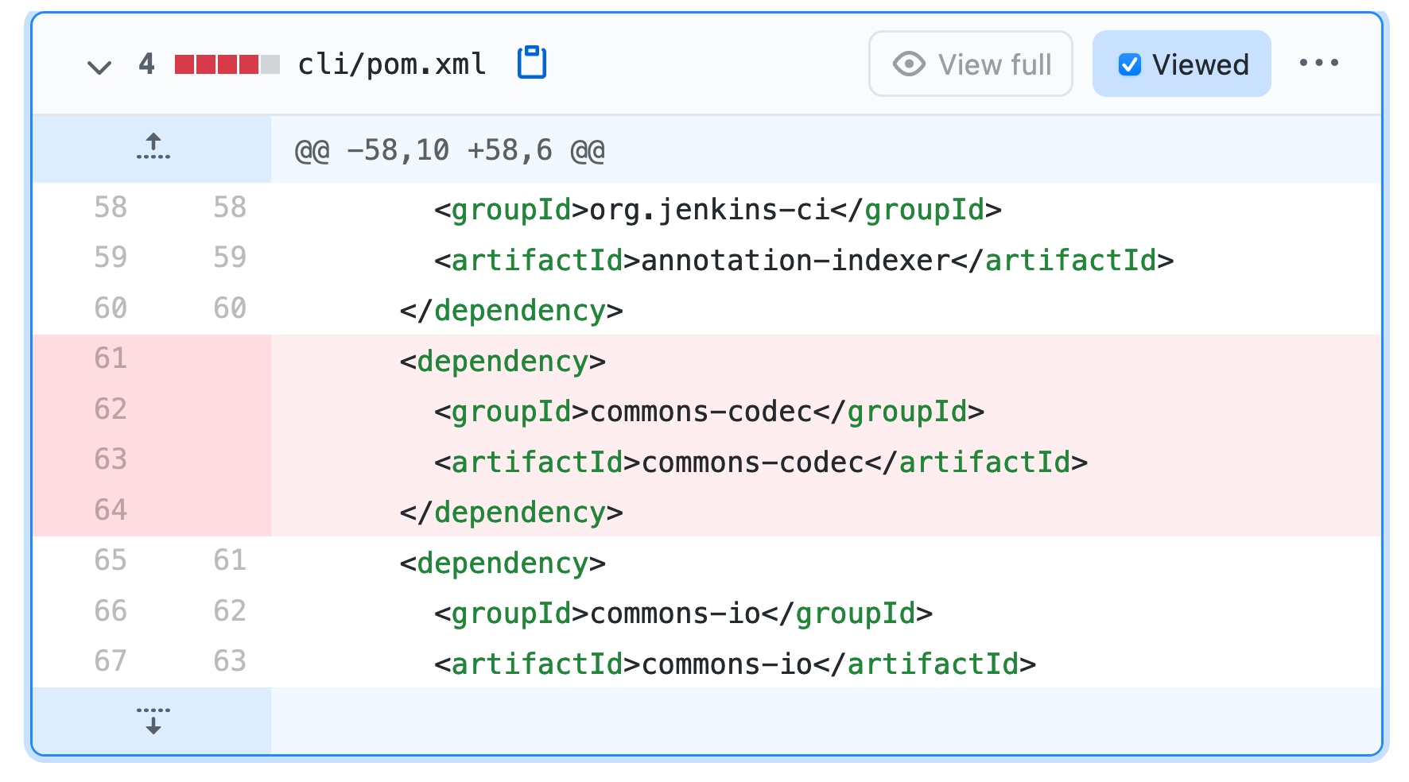
Code change
jenkins-cli
https://github.com/jenkinsci/jenkins/pull/4378
Notes:
With respect to the bloated dependency in jenkins-cli
This is the exact code change that we propose in the pom,
It is basically the removal of commons-codec

Slide 35
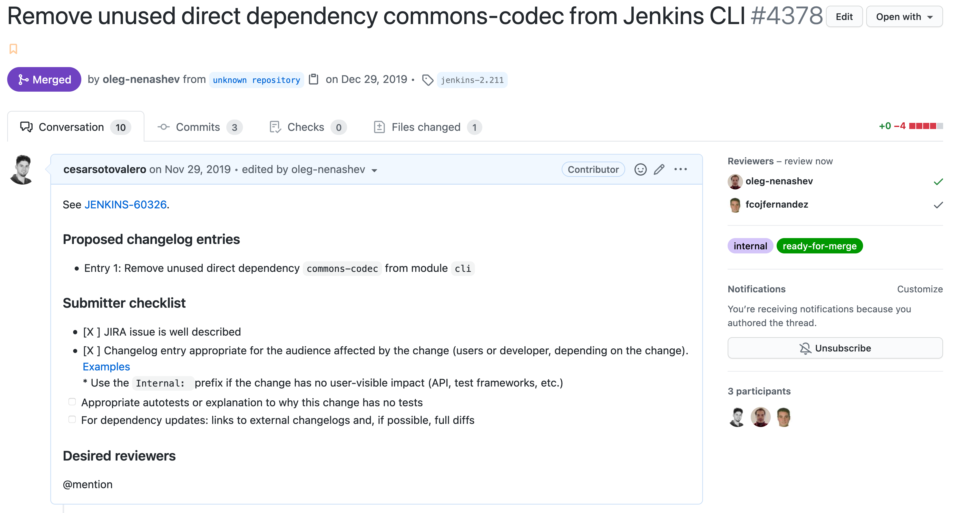
Merged pull request
https://github.com/jenkinsci/jenkins/pull/4378
Notes:
And it was accepted and merged by the Jenkins developers after a while

Slide 36
Conclusion
Notes:
To summarize

Slide 37
Conclusion
There is a lot of code bloat
Caused by the induced transitive dependencies
Caused by the heritage mechanism of multi-module projects
Caused by software development practices
Software developers care
For security
For performance
DepClean
Automatically detects and removes bloated dependencies
Notes:
There is a lot of code bloat out there
- Caused by the transitive dependencies that are induced as a result of the Maven dependency management mechanism
- Caused by the multi-module architecture
- And also caused by software development practices
Developers care about this issue, for multiple reasons. For example,
- For security, having fewer dependencies decrease the attack surface of their applications
- For performance, having smaller artifacts makes it easier to deploy and share them over the network
And DepClean
- It is a useful tool to automatically detect and remove bloated dependencies.

Slide 38
Demo time!
DepClean in action
Notes:
Now let’s see a quick demo of DepClean in action.

Slide 39
Thanks!

Slide 40
Open methodological questions
When to analyze dependency bloat?
Who is responsible for debloat direct, inherited, and transitive dependencies?
How to properly manage complex dependency trees to avoid dependency bloat?

